Slide 1
Kick-Off Digitalization Project Appletree With an illustrative Case Study on the Digitalization of Hazlenut Ltd.‘s Initial Procurement Process

Slide 2




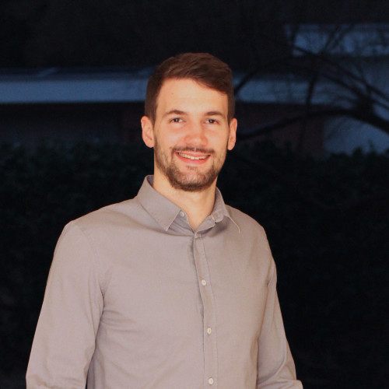

Welcome!
Salome Knecht (Organizer)
Partner / Head Digitalization of Business Processes
Kalari Consultancy Ltd.
Esther Zaugg (Prospective Customer of Kalari)
COO
Appletree Ltd.
Philipp Kempter (Former Customer of Kalari)
Process Owner Initial Procurement
Hazlenut Ltd.

Slide 3
Case Study Initial Procurement Process at Hazlenut
Manufacturer and distributor of valves, installation systems and housing technologies
Digitalization project Initial Procurement Process let by Kalari Consultancy Ltd. In January 2020
Successful project implementation in May 2020
Hazlenut nowadays is one of the very positive customer voices for Kalari Consultancy Ltd.
In cooperation with:

Slide 4
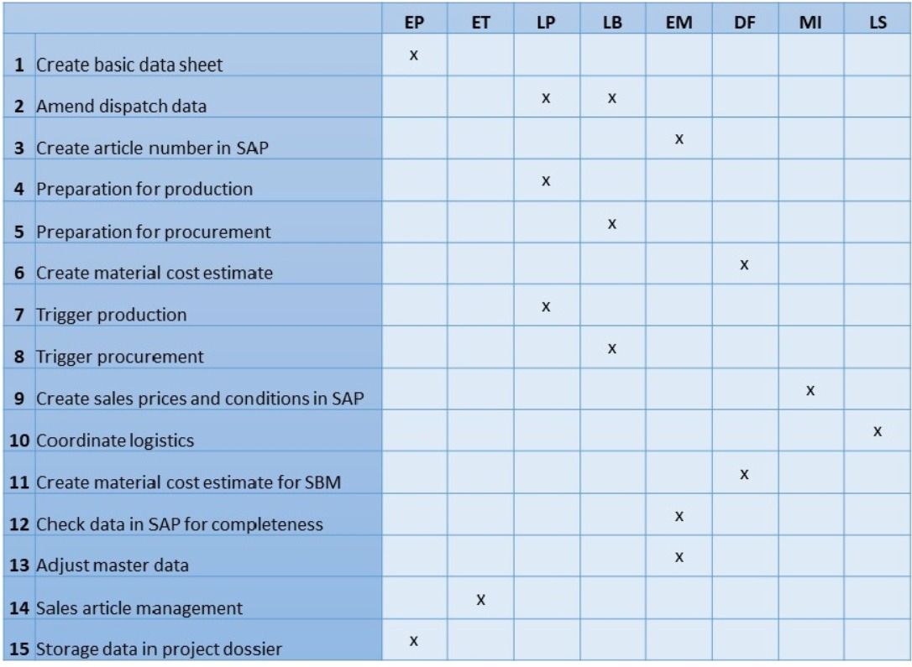
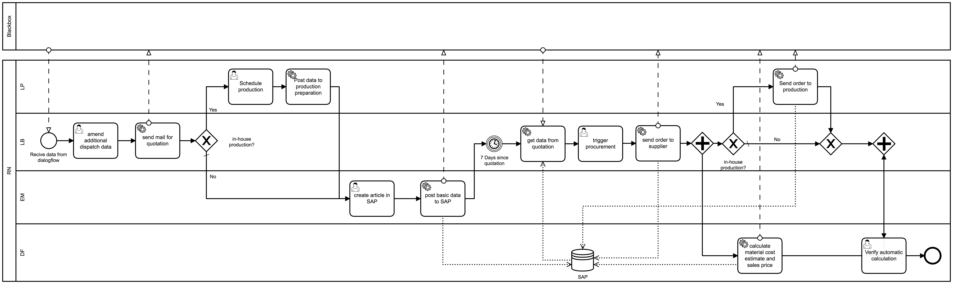
Case Study Initial Procurement Process Hazlenut (I/II)
Initial Procurement Process:
activities taken if a product is sold to a client for the first time. Unites all steps, from collecting data and specification of the product, creating it in SAP, triggering the component‘s procurement until the clearance for sales to the client.
Now
Process conduct entirely based on physical “Laufblatt“
Handwritten and sent via internal post
No standardization or digitalization
Data collection by chatbot
Automated supplier selection and contacting, data entry in SAP, order triggering and price calculation
Overall: much leaner and simpler process
In cooperation with:

Slide 5
Case Study Initial Procurement Process Hazlenut (II/II)
No standardization
No machine-readability and automatic processing
Potential for interpretation and misunderstandings
Hazard of data loss
No business continuity plan
Inefficiencies and a great amount of manual work
No central storage of data
Redundancies
Efficiency gains through smart automation, massive reduction of manual intervention
Standardized and structured data collection
Centralized storage of supplier responses
Digitalized workflow
Completeness and unambiguity of data
No unnecessary delays
Automated application of business rules and policies
Lean process with a clear overall structure
In cooperation with:

Slide 6
Thank you and Goodbye! Should you have any further questions, please do not hesitate to contact digibpkalari@gmail.com.

